Slide 1
Docker in Action: Creating and Testing Robust Microservice Systems
Workshop 06/05-2025

Slide 2

Agenda
# | Topic | Responsible | Time
1 | Introduction | Kristoffer | 09:00 - 09:05
2 | Getting started | Kristoffer | 09:05 - 09:45
 | Break |  | 09:45 - 09:55
3 | Resilience (and lunch break) | Andreas | 09:55 - 13:15
4 | Docker Compose in Visual Studio | Kristoffer | 13:15 - 13:30
5 | Integration testing | Kristoffer | 13:30 - 14:45
6 | Wrapping up | Kristoffer | 14:45 - 15:00

Slide 3

Up next
# | Topic | Responsible | Time
1 | Introduction | Kristoffer | 09:00 - 09:05
2 | Getting started | Kristoffer | 09:05 - 09:45
 | Break |  | 09:45 - 09:55
3 | Resilience (and lunch break) | Andreas | 09:55 - 13:15
4 | Docker Compose in Visual Studio | Kristoffer | 13:15 - 13:30
5 | Integration testing | Kristoffer | 13:30 - 14:45
6 | Wrapping up | Kristoffer | 14:45 - 15:00
Notes:
Instructors
Goals

Slide 4


Introduction
09:00 – 09:05
Instructors
Andreas Vorgaard
Kristoffer Lerbæk Pedersen
Topic Creating and Testing Robust Microservice Systems
Goals A general understanding of:
Resilient communication between microservices
Optimisations in the Docker build process
Integration testing with container dependencies

Slide 5

Up next
# | Topic | Responsible | Time
1 | Introduction | Kristoffer | 09:00 - 09:05
2 | Getting started | Kristoffer | 09:05 - 09:45
2.1 | Setup
2.2 | Hands-on
 | Break |  | 09:45 - 09:55
3 | Resilience (and lunch break) | Andreas | 09:55 - 13:15
4 | Docker Compose in Visual Studio | Kristoffer | 13:15 - 13:30
5 | Integration testing | Kristoffer | 13:30 - 14:45
6 | Wrapping up | Kristoffer | 14:45 - 15:00

Slide 6
Setting up your environment
09:05 – 09:45
Check out the repository:
github.com/Lerbaek/Docker-in-action
Switch to the branch:
1_setting-up-your-environment
Select docker-compose as startup project
Run solution
Invoke API
Notes:
Kristoffer

Slide 7
Hands-on: Run your first request
09:05 - 09:45
… Then break it
Check out the repository: github.com/Lerbaek/Docker-in-action
Switch to the branch: 1_setting-up-your-environment
Select docker-compose as startup project
Run solution
Invoke API
Set ServerStability header to Flaky
Handle the instability on the client side
Notes:
Kristoffer

Slide 8

Up next
# | Topic | Responsible | Time
1 | Introduction | Kristoffer | 09:00 - 09:05
2 | Getting started | Kristoffer | 09:05 - 09:45
 | Break |  | 09:45 - 09:55
3 | Resilience (and lunch break) | Andreas | 09:55 - 13:15
4 | Docker Compose in Visual Studio | Kristoffer | 13:15 - 13:30
5 | Integration testing | Kristoffer | 13:30 - 14:45
6 | Wrapping up | Kristoffer | 14:45 - 15:00

Slide 9

Up next
# | Topic | Responsible | Time
1 | Introduction | Kristoffer | 09:00 - 09:05
2 | Getting started | Kristoffer | 09:05 - 09:45
 | Break |  | 09:45 - 09:55
3 | Resilience | Andreas | 09:55 - 13:15
3.1 | RabbitMQ / MassTransit |  | 09:55 - 11:00
 | Lunch break |  | 11:00 - 11:45
3.2 | Hands-on |  | 11:45 - 13:15
5 | Docker Compose in Visual Studio | Kristoffer | 13:15 - 13:30
6 | Integration testing | Kristoffer | 13:30 - 14:45
7 | Wrapping up | Kristoffer | 14:45 - 15:00

Slide 10

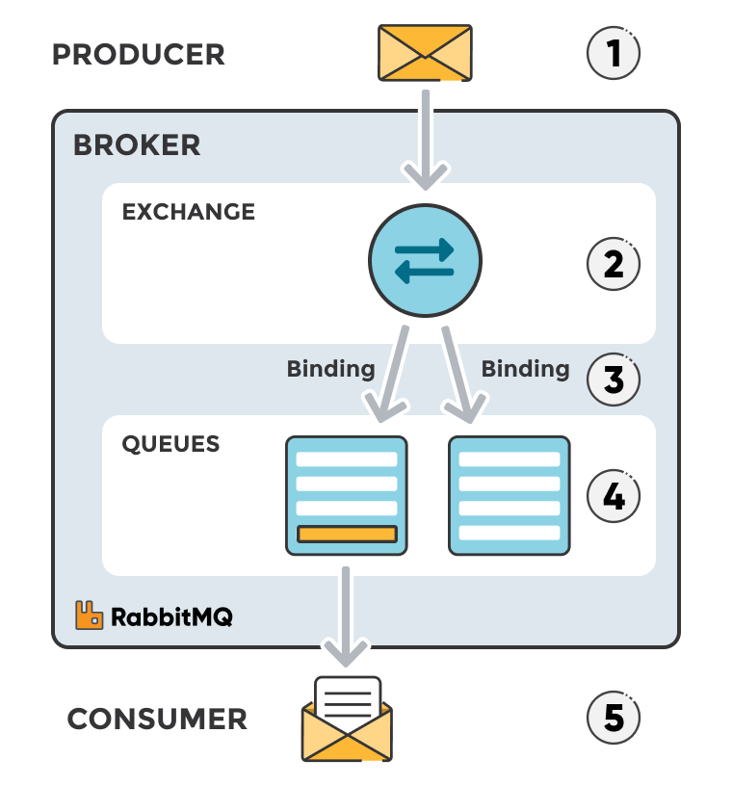
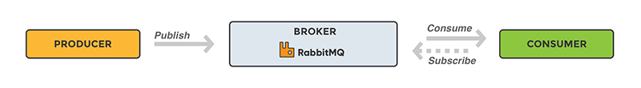
RabbitMQ
09:55 - 11:00
What is RabbitMQ?
Message broker
When and why to use?
What are exchanges, queues and bindings?
https://www.cloudamqp.com/blog/part1-rabbitmq-for-beginners-what-is-rabbitmq.html
https://www.rabbitmq.com/docs
https://www.rabbitmq.com/tutorials
Notes:
Andreas
What is RabbitMQ:
RabbitMQ is a message broker
Based on the pub/sub pattern, which is preferred over polling
Defines queues for delivering/receiving messages, any kind of messages
Basically works as with mail
When/why to use:
Reduces load: Long-running tasks can be done in specialized applications
Decouples applications: Application A doesn't need to know of Application B, only of the message sent from Application B (Usually a NuGet package)
Applications (partially) independently scalable: 1 producer, 500 consumers
Increased resilience: Awaits consumption by consumer & Consumer can utilize retry/redelivery (Though this has to be manually set up, there's not really built in functionality)
What are exchanges, queues and bindings?
Exchange (Mail office) is responsible for routing instead of a producer producing directly to a given queue --> This is based on things such as routing keys, exchange types, etc.
Queue (Mail box) is a buffer for the consumer to go and collect its received messages from
Binding (Postal route) defines where a given message should be sent and whether to send it to one or more queues

Slide 11
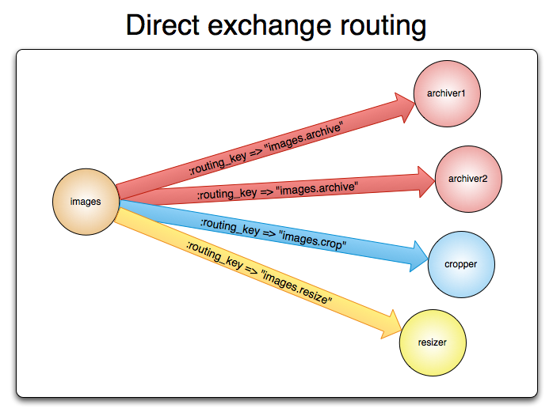
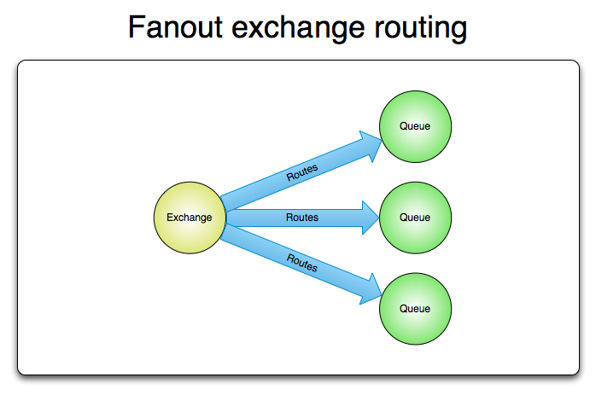
Exchanges
09:55 - 11:00
Based on routing key(s)
1-n consumers per routing key
Routing key ignored
All consumers receive the message
https://www.rabbitmq.com/tutorials/amqp-concepts
Notes:
Direct exchange
Queues are bound to an exchange via Routing keys
Only exchanges where routing key is exact match
Multiple consumers can be bound with same routing key
Fanout exchange
Routing key is ignored and every consumers receive the message
Ideal for broadcasting situation (Leaderboard updating)

Slide 12
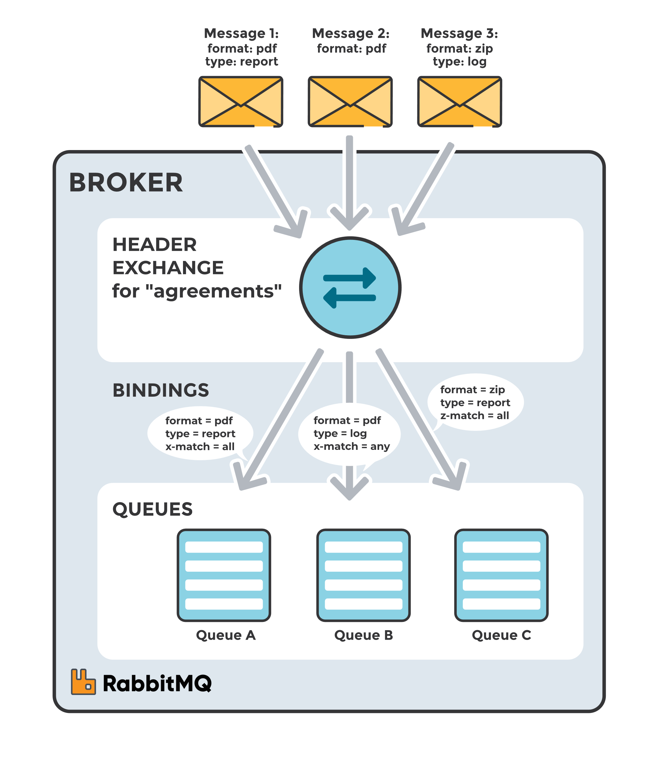
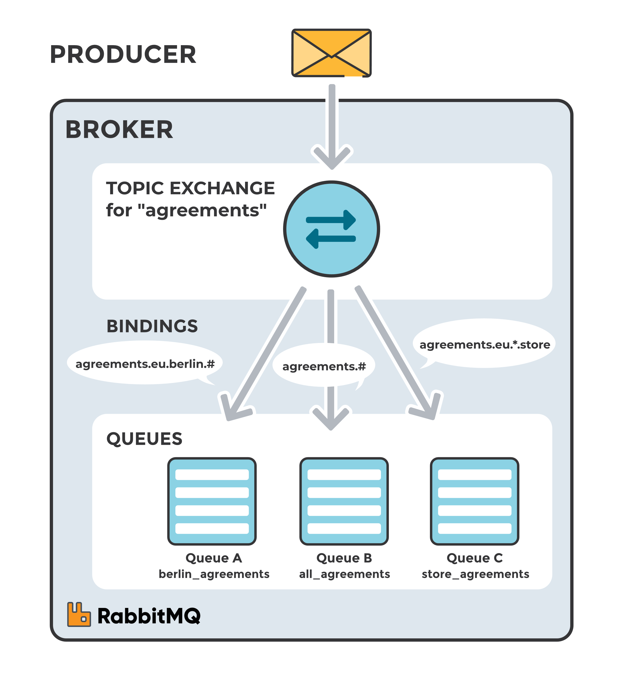
Exchanges
09:55 - 11:00
Topic exchange routing
Header exchange routing
Direct exchange with wildcards
Routes based on headers
Can match one or multiple
https://www.cloudamqp.com/blog/part4-rabbitmq-for-beginners-exchanges-routing-keys-bindings.html
Notes:
Topic exchange:
Basically the same as a direct exchange, but with wildcards in the bindings
* substitute for exactly one word
# substitute for zero or more words
Header exchange:
Routes based on headers instead of routing keys
Can be set to match one header or all headers specified upon binding
Example:
Message 1 sent to queue A and queue B
Message 2 sent to queue B
Message 3 sent to queue B
No message matches bindings for queue C

Slide 13
Glossary
09:55 - 11:00
Producer: Application which sends the message
Consumer: Application that receives the message
Queue: Buffer for storing messages
Message: Information sent from producer to consumer
Channel: Virtual connection within a connection used for publishing/consuming messages
Exchange: Receives messages from producers and pushes them to queues depending on rules. At least one per queue
Binding: Link between queue and an exchange
Routing key: Key which the exchange looks at to decide how to route the message
VHost / Virtual Host: Seggregation of application using the same RabbitMQ instance. Users have permissions for different VHosts and can't publish to exchanges it has no permission for
https://www.cloudamqp.com/blog/part1-rabbitmq-for-beginners-what-is-rabbitmq.html
Notes:
Exchange: Exchanges can also bind to exchanges, this is particularly done in MassTransit which we will talk about momentarily

Slide 14
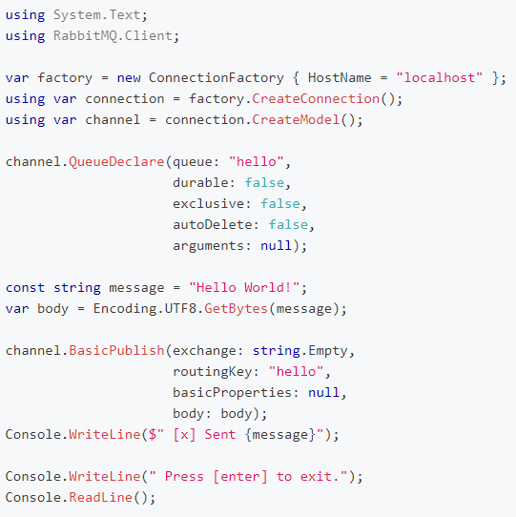
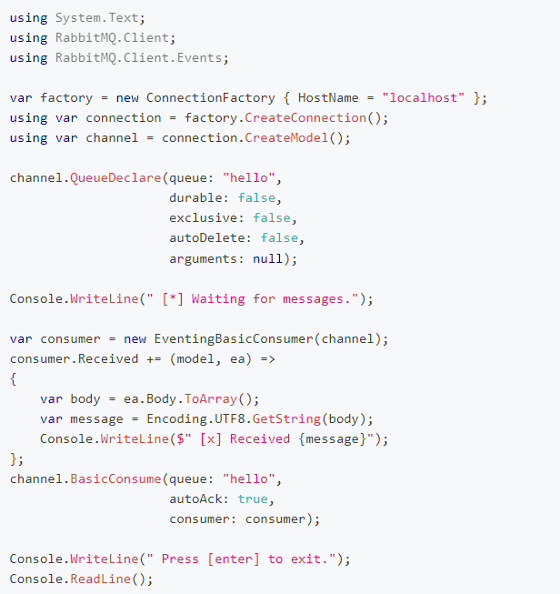
Setup in .NET
09:55 - 11:00
Producer
Consumer
1. Connecting to RabbitMQ
2. Virtual connection within RMQ
This is a whole lot of setup and duplicated code, and we haven't even started on exchanges/bindings...
3. Declaring queue
Luckily we can simplify this, by using MassTransit
4. Creating consumer
4. Publishing message
5. Define consumer logic
6. Binds consumer and queue
https://www.rabbitmq.com/tutorials/tutorial-one-dotnet
Notes:
We don't know if consumer or producer is set up first, so we set up the queue in both

Slide 15
Management
09:55 - 11:00
Images
Pure RabbitMQ
RabbitMQ with Management UI
Plugin used for information, debugging, admin functions and more
Demo: UI
Queues
Exchanges
Bindings
Consumers
Manual publishing/consuming
https://hub.docker.com/_/rabbitmq

Slide 16

MassTransit
09:55 - 11:00
What is MassTransit and why use it?
Open-source distributed application framework for .NET that provides a consistent abstraction on top of the supported message transports.
Consumer does the setup (typically)
Increased (potential) use of resilience
What type of exchange(s)?
All supported
Default: Fanout
Personal recommendation: Topic
NB!
As of v9, set for Q1 2026, MassTransit goes commercial.
While the principles still apply, it may be worth looking into alternatives.
https://masstransit.io/introduction
Notes:
Andreas
What is MassTransit?
Framework on top of RabbitMQ (& others):
You can go into depth and publish to specific exchanges/queues and such as you normally would with RMQ
OR You can keep it abstract and just publish a certain type of message, which is then connected to given consumers
Ease of setup/Reduces complexity: This can be seen on next slide, but generally we don't have to set up queues and bindings as with RMQ, that's done by MassTransit
Consumer does the setup (typically): RMQ had queue setup on both producer and consumer side, with MassTransit we can keep it defined in the consumer application.
This then also increases some risk, since we always have to update/start the consumer before we start publishing, otherwise the message will end up in limbo
Increased (potential) use of resilience:
If a message fails, it is put onto an error queue which can be set up with a consumer or can be handled manually (These are named [OriginalQueueName]_error)
If a message, and thereby exchange/queue, doesn't have a matching consumer then it is put onto a skipped queue (These are named [OriginalQueueName]_skipped)
It is possible and easy to set up retries as well as redeliveries with MassTransit.
Retry is easy to set up, requires single line of code. Retry happens within the current consumer (So a faulty consumer will continue failing even with retries)
Types of redelivery (Redelivery = put into back of queue):
Immediate: Immediately puts the message back onto the queue/exchange
Delayed (Requires plugin): Puts the message back onto the queue/exchange after a given time – Good for transient issues such as network issues
Plugin is old, outdated and has risky implementation due to not replicating the table where a message is saved
Scheduled (Requires scheduler/plugin): Quarts.NET, In-memory scheduler, Hangfire, etc. are possible schedulers. Used for longer retries, e.g. you can only try to process these messages at 2AM each day
Can be quite risky due to pod having to stay alive until the message has been redelivered
What type of exchange(s):
All are supported
Default is Fanout
Due to the flexibility of MassTransit we can also bind exchanges to exchanges – Usually an edge case, but it can occur

Slide 17
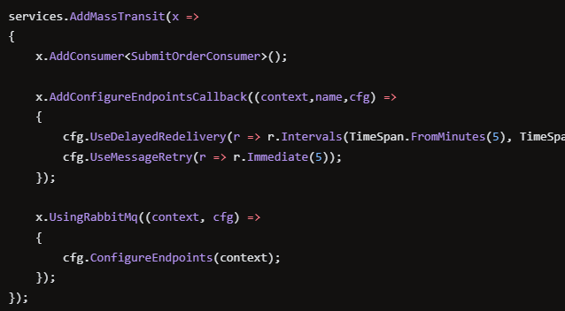
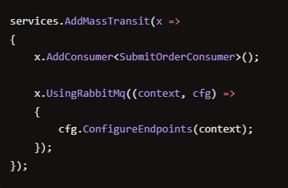
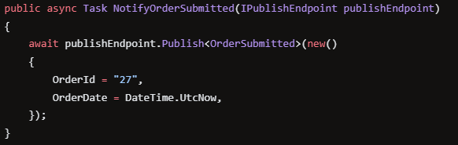
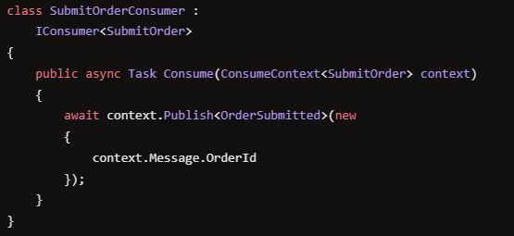
Setup in .NET
09:55 - 11:00
Service registration:
Service registration
MassTransit setup is set up as a pipe, so order matters
Localhost auth is set up by default
Message publication:
Can be dependency injected at constructor
Consumer implementation:
cfg.UseImmediateRedelivery() instead
https://masstransit.io/documentation/configuration#consumer-registration
https://masstransit.io/documentation/configuration#configure-endpoints
https://masstransit.io/documentation/concepts/exceptions#retry
https://github.com/rabbitmq/rabbitmq-delayed-message-exchange/issues/229
Notes:
Utilize UseImmediateRedelivery() instead of UseDelayedRedelivery() since that does not require plugin which is non-replicated
Localhost auth is set up by default, but in a real production environment you should always ensure to use AppSettings or other to load in Username, Password, Port, Host and more.

Slide 18

Up next
# | Topic | Responsible | Time
1 | Introduction | Kristoffer | 09:00 - 09:05
2 | Getting started | Kristoffer | 09:05 - 09:45
 | Break |  | 09:45 - 09:55
3 | Resilience | Andreas | 09:55 - 13:15
3.1 | RabbitMQ / MassTransit |  | 09:55 - 10:35
 | Lunch break |  | 11:00 - 11:45
3.2 | Hands-on |  | 11:45 - 13:15
4 | Docker Compose in Visual Studio | Kristoffer | 13:15 - 13:30
5 | Integration testing | Kristoffer | 13:30 - 14:45
6 | Wrapping up | Kristoffer | 14:45 - 15:00

Slide 19
Hands-on: Implementing RabbitMQ with MassTransit
11:45 - 13:15
Build on your own implementation or switch to the branch:
2_implementing-rabbitmq-with-masstransit
Change API communication to RabbitMQ via MassTransit
Include retry logic to improve resillience
Introduce constant error on server side
Verify that error queue works
Inspect in UI what information you get when a message is on the error Queue
Try debugging across services
Optional: Add redelivery to the system as well
You can use the context.GetRedeliveryCount()to verify that it's redelivered
Optional: Add response from server to client via RabbitMQ/MassTransit
Potentially look at RPC (outside scope of this course)
References: https://masstransit.io/documentation/configuration
Notes:
Andreas

Slide 20

Up next
# | Topic | Responsible | Time
1 | Introduction | Kristoffer | 09:00 - 09:05
2 | Getting started | Kristoffer | 09:05 - 09:45
 | Break |  | 09:45 - 09:55
3 | Resilience (and lunch break) | Andreas | 09:55 - 13:15
4 | Docker Compose in Visual Studio | Kristoffer | 13:15 - 13:30
5 | Integration testing | Kristoffer | 13:30 - 14:45
6 | Wrapping up | Kristoffer | 14:45 - 15:00

Slide 21

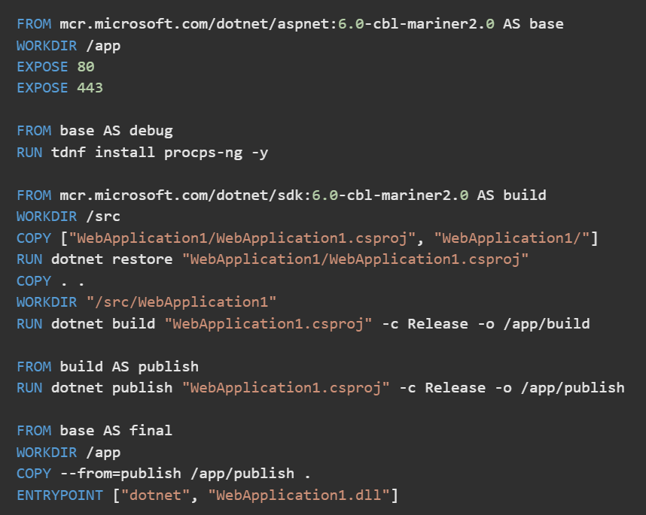
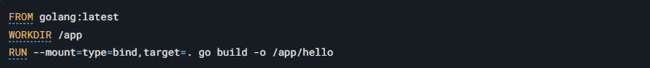
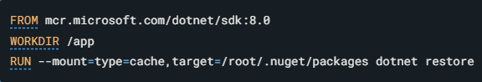
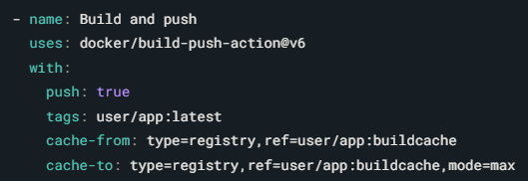
Docker build optimisation
13:15 – 13:30
Docker Compose caching
How it works
Advantages
Disadvantages
Best practices
Visual Studio’s Fast mode
How it works
Advantages
Disadvantages
Best practices
https://docs.docker.com/build/cache/
https://learn.microsoft.com/en-us/visualstudio/containers/container-build
Notes:
Docker Compose Caching
How it works: Line by line reuse. Built-in commands can check the file system for changes.
Advantages Optimized build speed
Disadvantages Large, complex, redundantly implemented Dockerfiles
Best practices
Order your layers
Copy project files before code files to reduce NuGet restores.
Build dependency projects before dependent projects.
Keep the context small
Copy project files and restore before copying code files.
Split restore, build and publish commands
Use bind mounts
Instead of copying files into the build container, a bind mount allows for a temporary mount, from which the files will never be cached.
Reduces cache size buildup for large contexts
Good when files are not needed in final container, and files always change between builds
Use cache mounts
Mounting a cache (NuGet cache, for instance) makes restoration much faster in case of cache invalidation.
Use an external cache
In case of multiple build agents, a cached layers may be shared.
Fast mode
How it works: In Fast mode, Visual Studio builds the project on the local machine and uses Docker to run the app, rather than building the entire Dockerfile.
Enabled in Debug build configuration by default: Fast mode is activated by default when you build your projects in Debug mode. This setting optimizes the development process by skipping certain build stages.
Configurable in project file:
Enabled
Last included stage
Advantages
Faster builds: This mode significantly reduces build times by avoiding full Docker builds, which can be time-intensive.
Encourages multi-stage builds: Promotes the use of Docker's multi-stage build features, allowing developers to separate build environments and minimize the final image size.
Disadvantages
Limited environment simulation: Fast mode does not create a build environment that completely mimics the production environment, which could lead to overlooked environment-specific issues.
Confusing for the uninitiated: New developers or those unfamiliar with Docker might find the discrepancies between development and production environments confusing, especially when debugging issues that do not appear locally.
Best practices
Awareness: Team members should be made aware of the differences between Fast mode and regular builds, and documentation should clearly outline when each mode is used.
Selective use: Use Fast mode primarily for development to benefit from rapid iteration. Regular full Docker builds should be scheduled to ensure compatibility and performance in the production environment.

Slide 22

Up next
# | Topic | Responsible | Time
1 | Introduction | Kristoffer | 09:00 - 09:05
2 | Getting started | Kristoffer | 09:05 - 09:45
 | Break |  | 09:45 - 09:55
3 | Resilience (and lunch break) | Andreas | 09:55 - 13:15
4 | Docker Compose in Visual Studio | Kristoffer | 13:15 - 13:30
5 | Integration testing | Kristoffer | 13:30 - 14:45
5.1 | Discussion |  | 13:30 - 13:45
5.2 | Presentation |  | 13:45 - 14:15
5.3 | Hands-on |  | 14:15 - 14:45
6 | Wrapping up | Kristoffer | 14:45 - 15:00

Slide 23


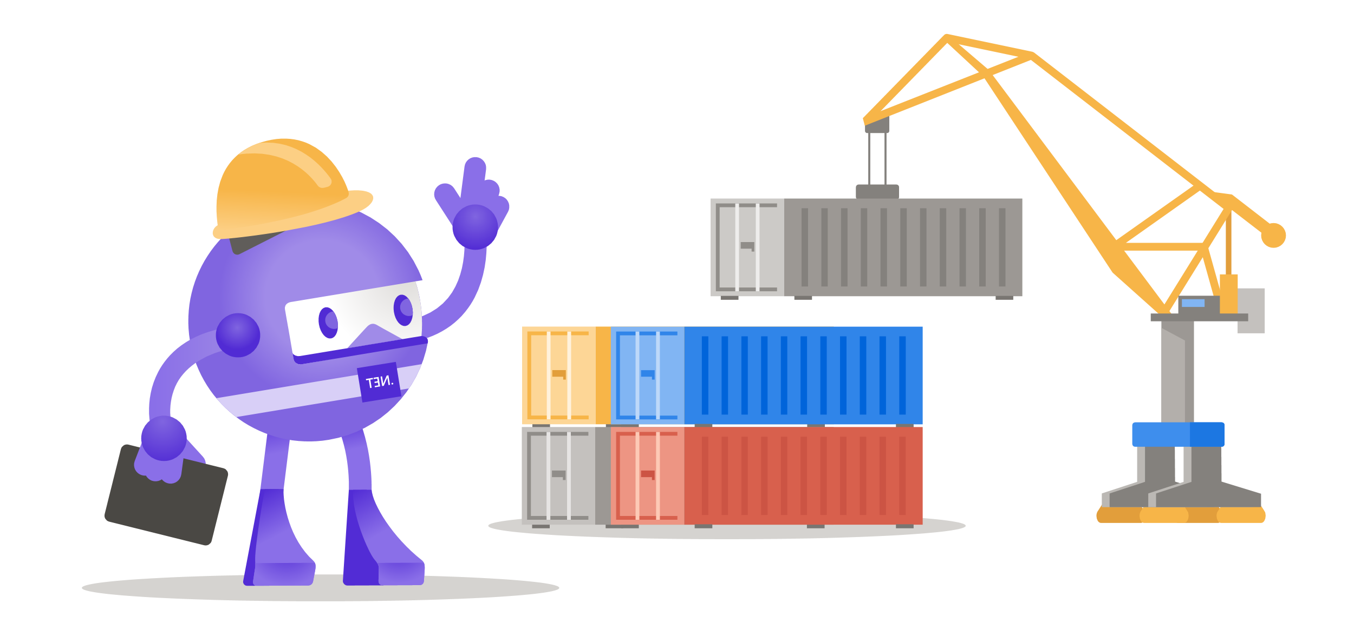


Discussion: Integration testing with 3rd party dependencies
13:30 – 13:45
Real dependencies
Environment consistency
Central component management
Data isolation and cleanup
Service accessibility
Service availability
Docker / Docker Compose
Management
Cleanup
Conflicts
Reusability
Health checks
Requires low-level Docker knowledge
Integration with IDE
Slow initialization
Resource requirements
Docker dependency
In-memory substitutions
Substitute availability
Behavioural fidelity
Features
Connectivity
Configuration and version compatibility
Concurrency
Data migration
.NET Aspire
Focus on local development orchestration, not testing
New technology with limited community
.NET only
Somewhat tied to Azure
Notes:
Real Dependencies:
Environment Consistency: Challenges include maintaining uniform test environments as external dependencies do not always operate predictably.
Central Component Management: Concerns the need for ongoing maintenance of a central component to prevent widespread test failures due to neglect or during updates.
Data Isolation and Cleanup: Ensures tests run in isolation without residual data affecting outcomes, which can be challenging with real dependencies.
Service Accessibility: Ensuring services are reachable from development environments and pipelines, possibly complicated by network configurations like firewalls.
Service Availability: Addresses the reliability of external services being operational and accessible when needed for testing.
In-memory Substitutions:
Substitute Availability: Challenges in finding appropriate and functional substitutes, such as the lack of a direct in-memory equivalent for MS SQL in .NET environments.
Behavioural Fidelity: In-memory substitutes may not perfectly mimic the behaviors of real dependencies, potentially leading to gaps in testing fidelity.
Feature Completeness: In-memory substitutes might not support all features of the actual dependency, limiting the scope of testing.
Network Connectivity Simulation: Does not replicate real network interactions, which can lead to overlooked issues in production.
Configuration and Version Compatibility: Simplified setups may not reflect complex production configurations, risking compatibility oversights.
Concurrency Handling: In-memory models may not adequately simulate the load and concurrent processing capabilities of real systems.
Data Migration Challenges: Testing data migration with in-memory systems might not reveal all the complexities of migrating between different versions or types of real databases.

Slide 24
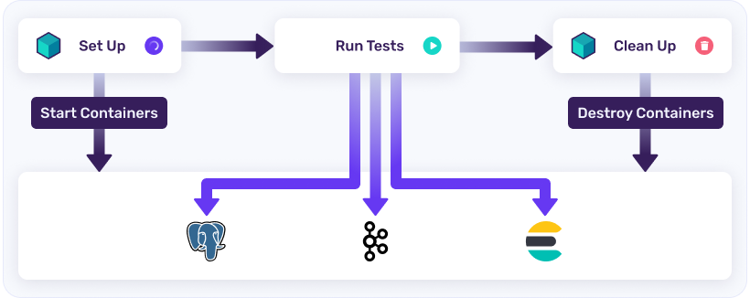
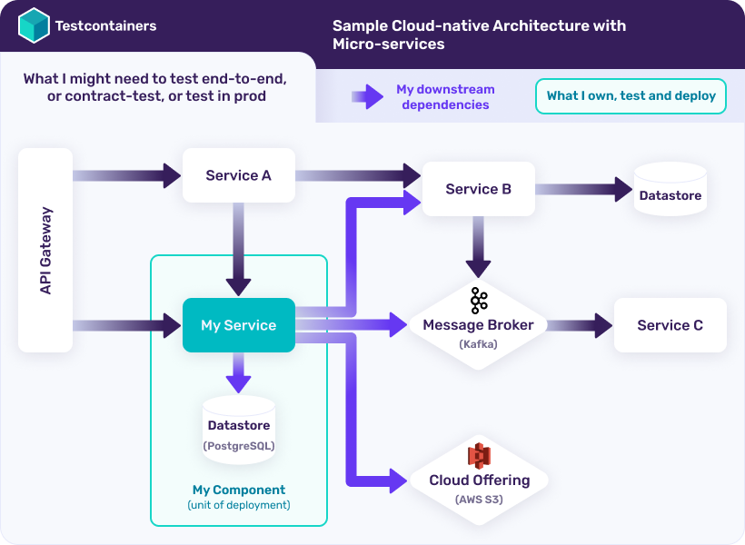
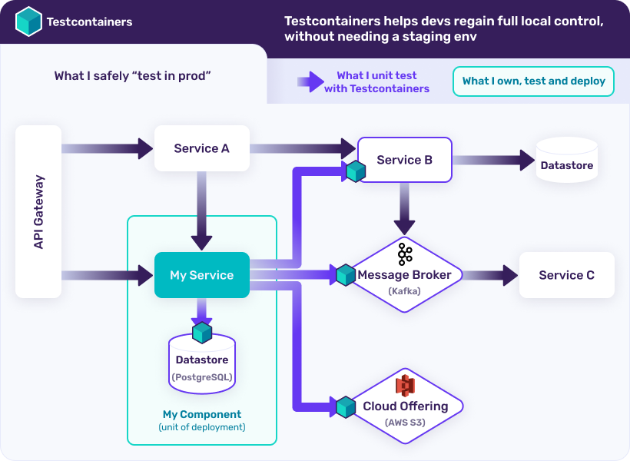
Testcontainers: The basics
09:20 – 09:30
What?
Lightweight, throwaway containers with real services
Managed infrastructure
Fluent bootstrapping in code
Why?
Ease of use
Consistency
Realism
Availabilityy
Image/version
Configuration
State
Scope
Disposability
CI/CD compatibility
https://testcontainers.com/getting-started/

Slide 25
Testcontainers: The basics
09:20 – 09:30
What?
Lightweight, throwaway containers with real services
Managed infrastructure
Fluent bootstrapping in code
Why?
Ease of use
Consistency
Realism
Flexibility
Image/version
Configuration
State
Scope
Disposability
CI/CD compatibility
https://testcontainers.com/getting-started/

Slide 26


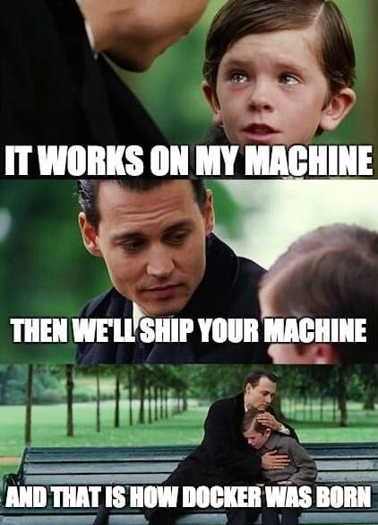









Testcontainers: The basics
09:20 – 09:30
What?
Lightweight, throwaway containers with real services
Managed infrastructure
Fluent bootstrapping in code
Why?
Ease of use
Flexibility
Configuration
State
Scope
Consistency
Realism
Availability
Disposability
CI/CD compatibility
RabbitMqContainer container = new RabbitMqBuilder().Build();
.WithImage("rabbitmq:3.11.20-management").Build();
.WithPortBinding(15672, assignRandomHostPort: true).Build();
.WithName($"rabbitmq-{Guid.NewGuid()}").Build();
.WithEnvironment("ASPNETCORE_ENVIRONMENT", "Integration").Build();
.WithNetwork("my-network")
.WithEntrypoint([…])
.WithCommand([…])
[…]
.Build();
await container.StartAsync();
var connectionString = container.GetConnectionString();
await container.ExecAsync(["sudo rm /"]);
https://testcontainers.com/getting-started/

Slide 27
Hands-on: Integration testing with RabbitMQ dependency
14:15 – 14:45
Build on your own implementation or switch to the branch:
3_integration-testing-with-rabbitmq-dependency
Run tests
ClientTests
ServerTests
Works?
Add more tests
Try testing the consumer without starting the entire service
Play around!
Try breaking by the test harness. What else can it do?
Worksn’t?
Fix it!
Should the tests be changed to fit your code?
Should your code be changed to make it more testable?

Slide 28

Up next
# | Topic | Responsible | Time
1 | Introduction | Kristoffer | 09:00 - 09:05
2 | Getting started | Kristoffer | 09:05 - 09:45
 | Break |  | 09:45 - 09:55
3 | Resilience (and lunch break) | Andreas | 09:55 - 13:15
4 | Docker Compose in Visual Studio | Kristoffer | 13:15 - 13:30
5 | Integration testing | Kristoffer | 13:30 - 14:45
6 | Wrapping up | Kristoffer | 14:45 - 15:00

Slide 29

Outroduction
14:45 – 15:00
Key points
Handling transient vs. consistent errors
RabbitMQ/MassTransit
Visual Studio’s Fast Mode for Docker build optimisation
Testcontainers for for integration testing with container dependencies
Feedback
Difficulty?
Scope?
Pace?

